Slide 1
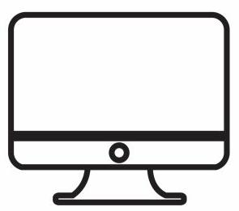

JAVA CLASS 6
SOCKET PROGRAMMING

Slide 2
Switching to inter-connection of machines
-> System A wants to connect to System B. But How?
A will have to send request to B. But Does A know B ?
So get the IP ADDR of B and also the port . But Is B ready for connection?
Make B ready for connection
B will have to accept and you are ready to go

Slide 3
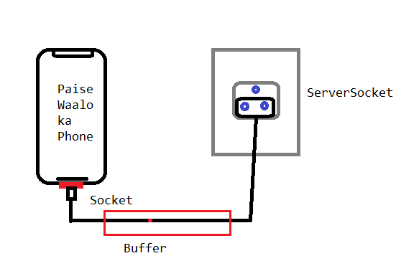
SO What are sockets ?
-> The Lower most level of networking between systems.
-> The End Point of a System
Let me Get you straight

Slide 4
Streams and Buffers
Lets LOOK AT THIS WITH AN ANALOGY →
Stream Of River
Pipeline
Bucket
Flushing out the bucket
DATA STREAM Buffer flush()
(can be any data (Input/Output/Error) (Unbuffered/Line Buffered
String, object , etc.) Fully Buffered)

Slide 5
CLIENT AND SERVER
In simple but accurate terms :-
Server -> Service Provider
Client -> The one who requests for and then uses that service
->> In Our Design ,
The system that sends request for connection is the CLIENT
And the one Who Accepts the connection is the SERVER.
Be clear with this !

Slide 6
LET THE CODE DO THE TALKING
Marker Interfaces (Serializable)
Feature Implementation using Exception Handling
Brief About 2-way communication using sockets
UDP SOCKETS
Applications and usage

